Slide 1
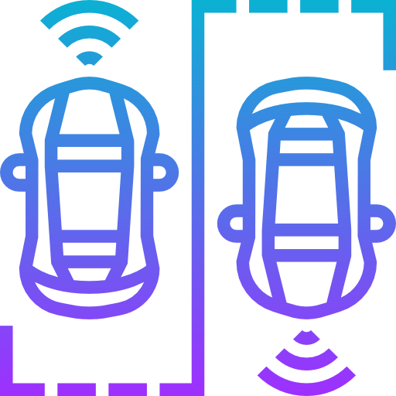
Self-Driving Cars: Object Detection
Asha Asvathaman
Engineering Graduate Student at U of T

Slide 2
Goal
Object detection -Pedestrians -Cars -Cyclists

Slide 3
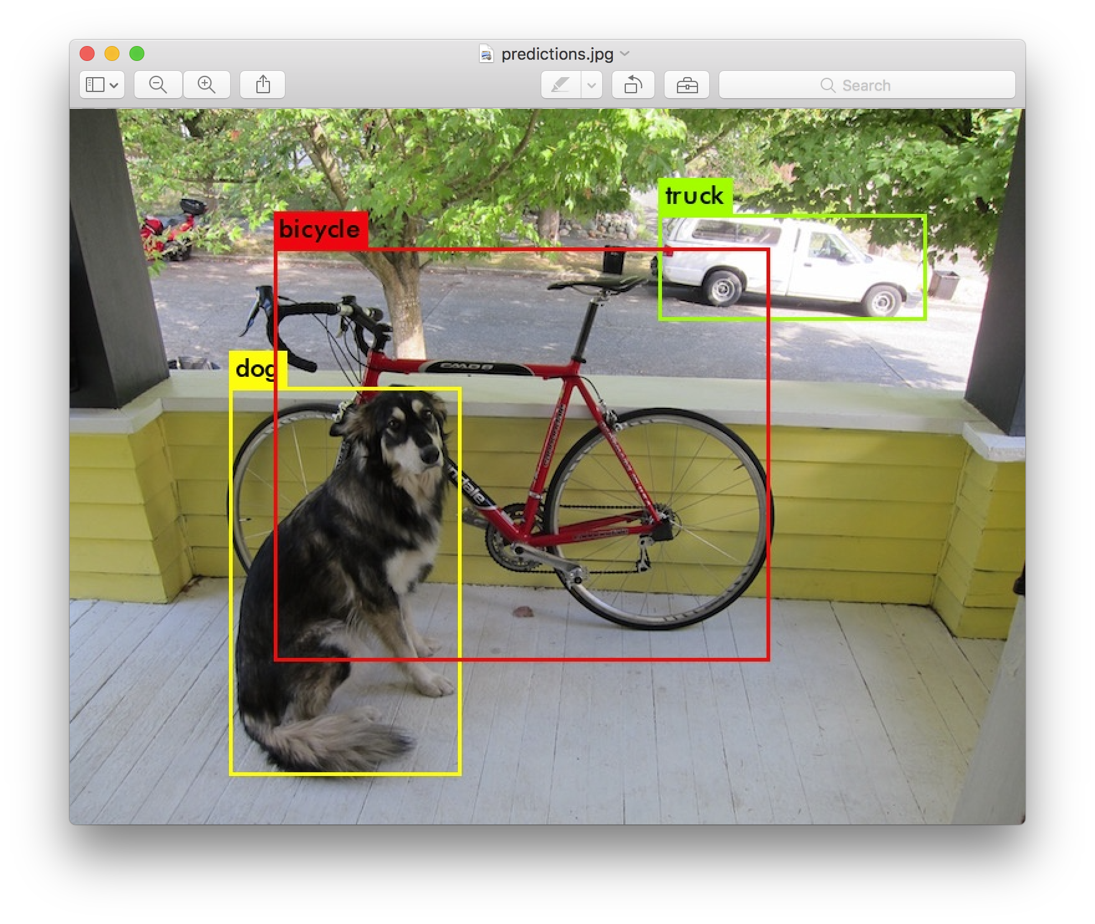
Object Detection
Classification
Localization

Slide 4
Tiny YOLO v3
Real time implementation
Lots of resources (https://pjreddie.com/darknet/yolo/)

Slide 5


Tiny YOLO
Grid cell
Bounding Box

Slide 6
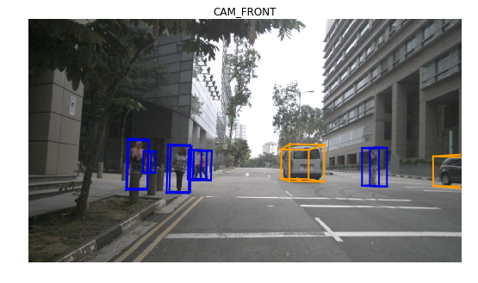
Dataset
nuScenes by nuTonomy (www.nuscenes.org):
-Boston and Singapore
-Expert annotators

Slide 7
nuScenes – devkit tutorial
Python 3.6 or 3.7
https://www.nuscenes.org/tutorial

Slide 8
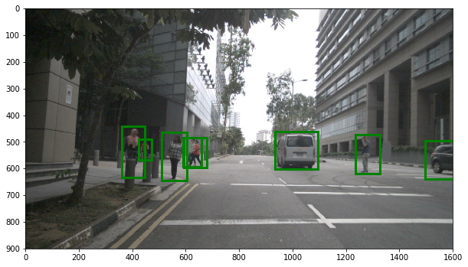
3D to 2D Bounding Boxes
Computer vision
nuScenes module
numpy

Slide 9
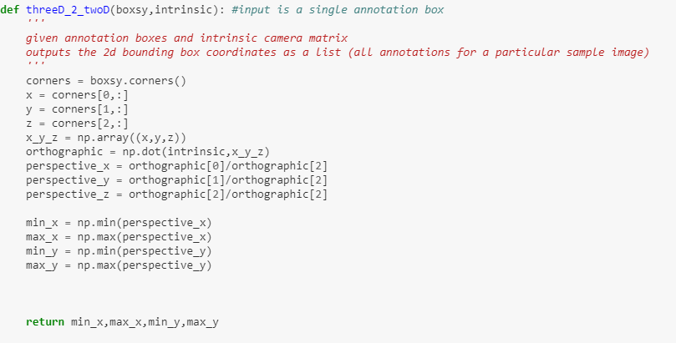
https://github.com/asvath/mobile_robotics

Slide 10
Hardware
Google Colab: - Free! - GPU : Nvidia K80 (now Tesla T4) - Linux - Python - Google Drive

Slide 11
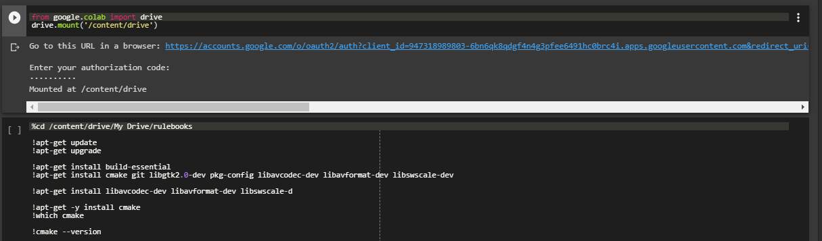
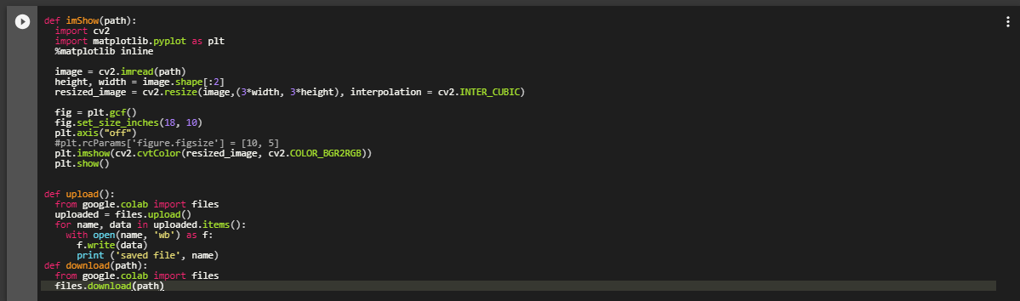

Slide 12
Training: 1 – 3 days
Limitations: - 12 hour time frame - 90 min

Slide 13
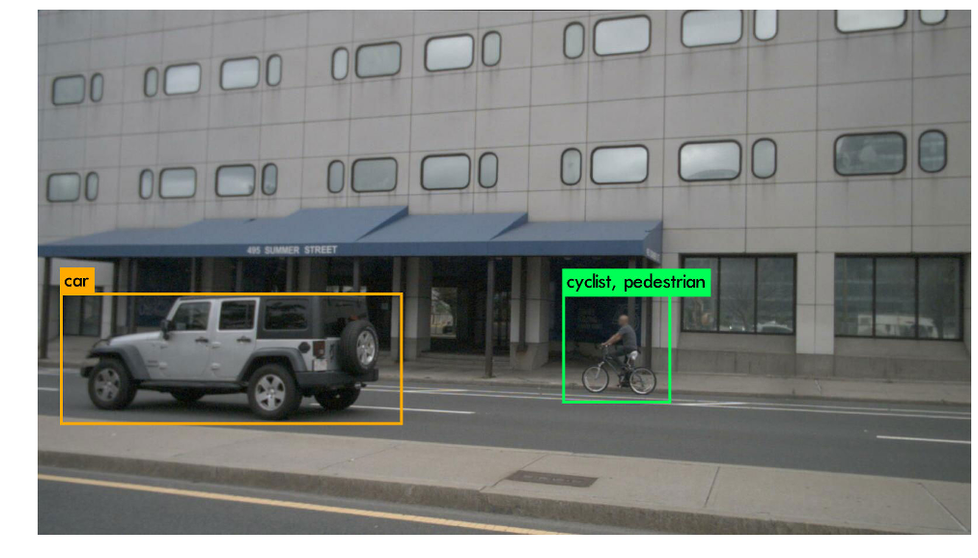
Sample predictions

Slide 14
Video of Results
https://youtu.be/hmpNFlYn0yo

Slide 15
Summary
Object detection
Tiny YOLO
nuScenes
Google Colab
Results

Slide 16
Thank you!
Questions?

Slide 17
Backup Slides

Slide 18
- Trained 5 models: 12,000 iterations
- Validation
Resolution | Batch | Subdivision | Highest mAP(%)
416 | 64 | 2 | 48.32
416 | 64 | 8 | 48.51
512 | 64 | 16 | 36.39
832 | 64 | 8 | 61.76
832 | 64 | 32 | 61.46

Slide 19
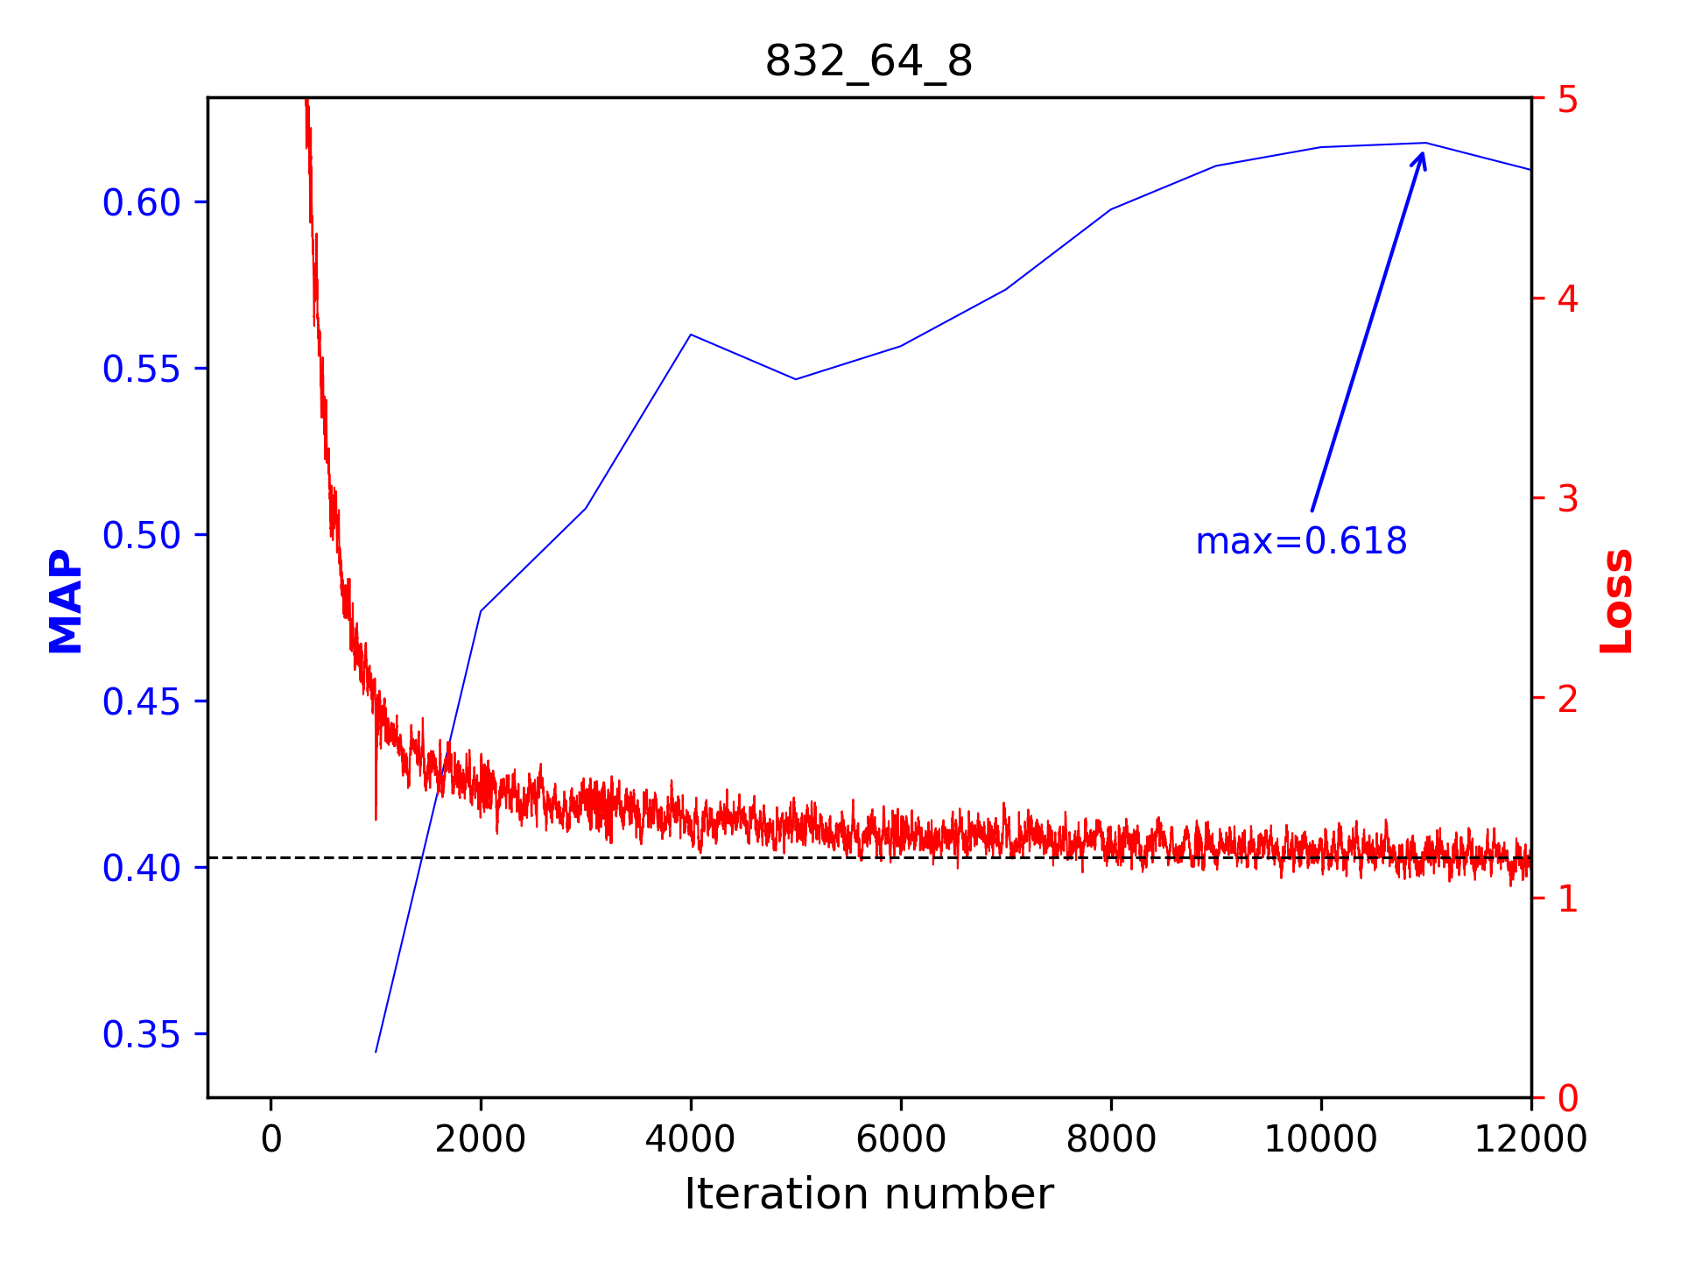

Slide 20
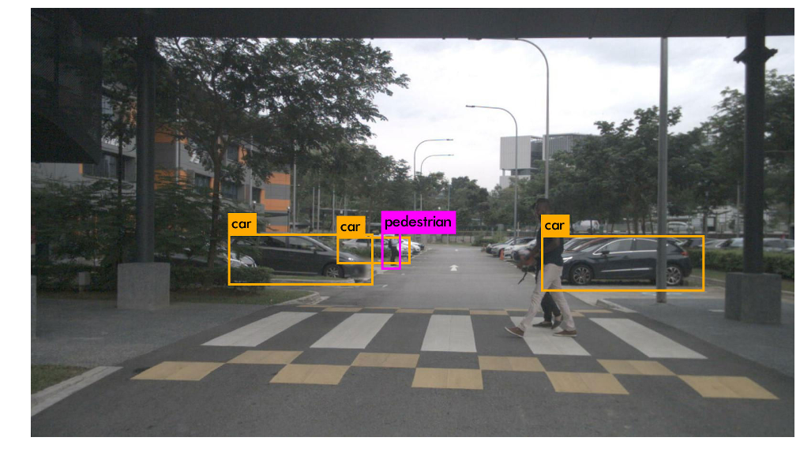
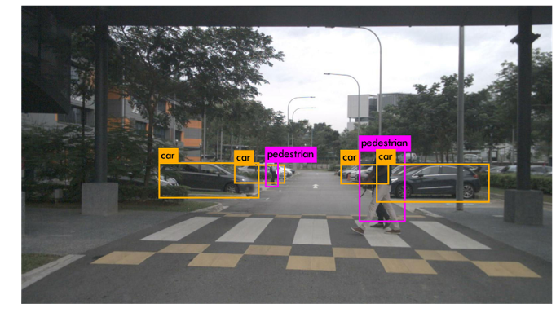

Slide 21
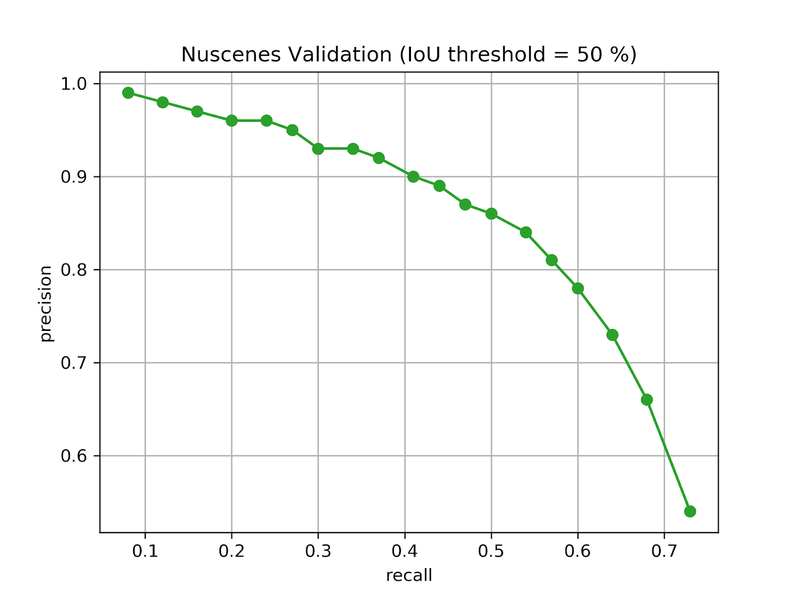
Confidence score threshold of 10% was selected for detection. At this threshold, the precision is 0.66, recall is 0.68, and F-1 score is 0.67

Slide 22
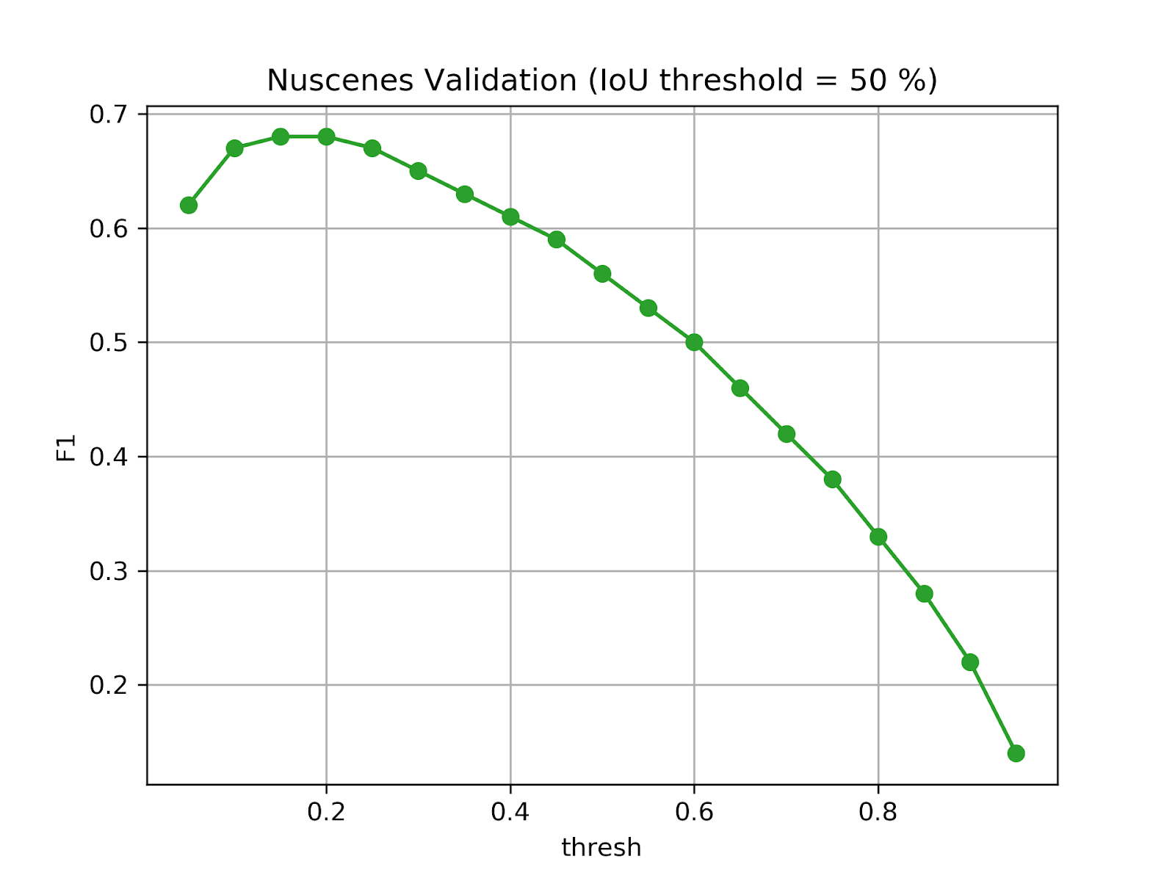
where a high F1 indicates a high precision and high recall value. This occurs at threshold 20% with F1 score of 0.68, precision of 0.78 and recall of 0.60.

Slide 23
